Slide 1
Digital Portfolio
Unit 3

Slide 2
tags
<p> hello world! </p>
<h1> this is a title </h1>
<b>bold</b>
<i>italic</i>
<img src=“kite.jpg”>

Slide 3
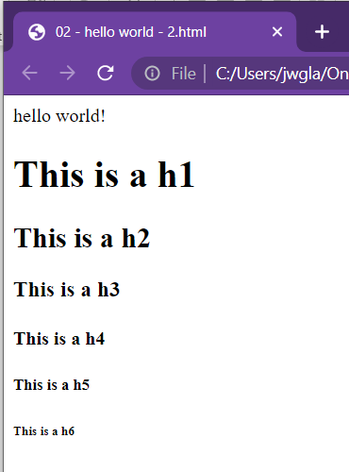
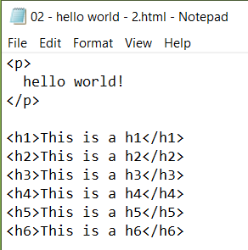
Heading tags

Slide 4
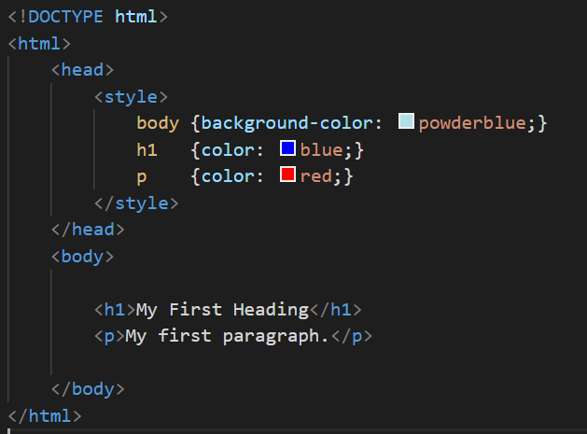
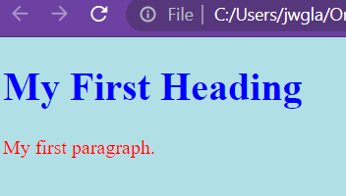

Slide 5

TAG attributes
Missing image

Slide 6

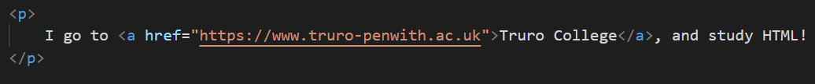
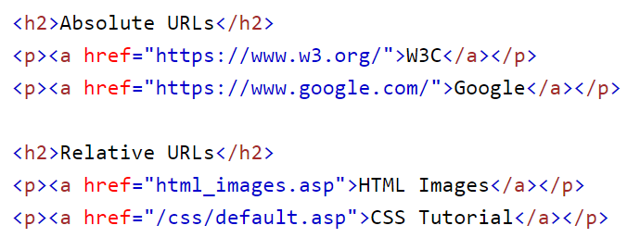
Anchor tags

Slide 7
lists
Unordered
Ordered
Nested

Slide 8
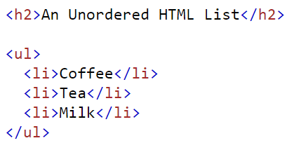
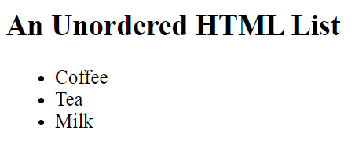
Task:
Copy template.html
Name it -> unordered-list.html
Add an unordered list into it --- your top 5 games or books

Slide 9
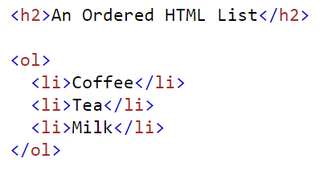
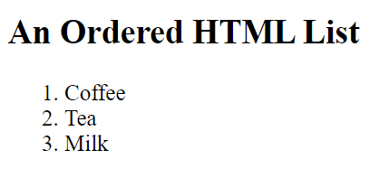
Task:
Copy template.html
Name it -> ordered-list.html
Add an ordered list into it ---- a cookie recipe

Slide 10
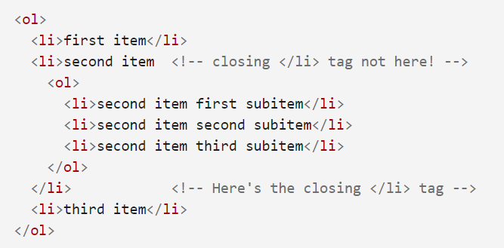
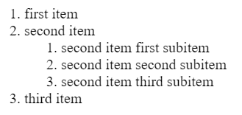
Task:
Copy template.html
Name it -> ordered-list.html
Add an ordered list into it ---- a cookie recipe

Slide 11
Today - tables
Tables of data
Four new tags
<table>
<tr>
<th>
<td>

Slide 12
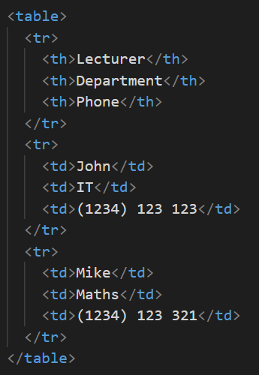
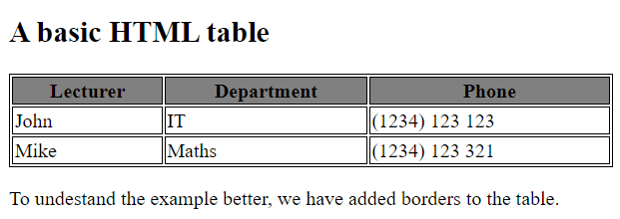

Slide 13
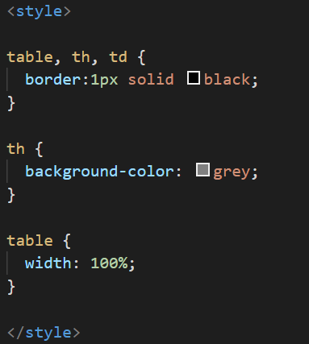
Task:
Copy template.html
Name it -> table.html
Add all prog 2 students into it, favourite Pokémon,

Slide 14
Task:
Copy template.html
Name it -> table.html
Columns:
Name
Fav Pokémon
Fav Film
Height in cm
Fav Burger
Add all students into it

